Slide 1
Unit 2
Er.Sudan Prajapati

Slide 2
INTERNET ADDRESSES
Devices connected to the Internet are called nodes. Nodes that are computers are called hosts. Each node or host is identified by at least one unique number called an Internet address or IP address.
Most current IP addresses are 4-byte-long IPv4 addresses. However, a small but growing number of IP addresses are 16-byte-long IPv6 addresses.
An IPv4 address is normally written as four unsigned bytes, each ranging from 0 to 255. Bytes are separated by periods for the convenience of human eyes. For example, the address for javatpoint is 104.21.79.8. This is called the dotted quad format.
An IPv6 address is normally written as eight blocks of four hexadecimal digits separated by colons. For example, the address of www.javatpoint.com is 2606:4700:3037::6815:4f08. Leading zeros do not need to be written

Slide 3
A double colon, at most one of which may appear in any address, indicates multiple zero blocks. For example, the address 2001:4860:4860:0000:0000:0000:0000:8888 can be written as 2001:4860:4860::8888.
In mixed networks of IPv4 and IPv6, the last four bytes of the IPv6 address are sometimes written as an IPv4 dotted quad address.
• For example, FEDC:BA98:7654:3210:FEDC:BA98:7654:3210 could be instead written as FEDC:BA98:7654:3210:FEDC:BA98:118.84.50.16.
The internet’s designer invented the Domain Name System (DNS).

Slide 4
The InetAddress Class
The java.net.InetAddress class is high-level representation of an IP address, both IPv4 and IPv6.
It is used by most of the other networking classes, including Socket, ServerSocket, URL, DatagramSocket, DatagramPacket and more. Usually, it includes both a hostname and an IP address.
Creating New InetAddress Objects
There are no public constructors in the InetAddress class. Instead, InetAddress has static factory methods that connect to a DNS server to resolve a hostname. The most common is InetAddress.getByName().
For example, this is how we look up www.javatpoint.com:
InetAddress address = InetAddress.getByName(“www.javatpoint.com”); It actually makes connection in the local DNS server to look up the name and the numeric address and if the DNS server can’t find the address, this method throws an UnknownHostException, a subclass of IOException

Slide 5
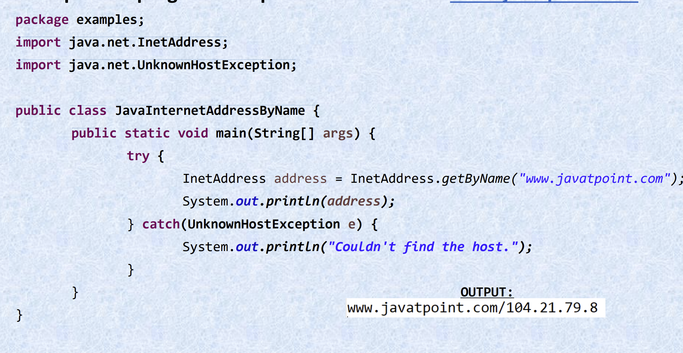
Example 1: A program that prints the address of www.javatpoint.com.

Slide 6
We can also do a reverse lookup by IP address. For example, if we want the hostname for the address 104.21.79.8, passing the dotted quad address to InetAddress.getByName(): InetAddress ia = InetAddress.getByName("104.21.79.8"); System.out.println(ia.getHostName());
If the address we look up doesn’t have a hostname, getHostName() simply returns the dotted quad address we supplied.

Slide 7
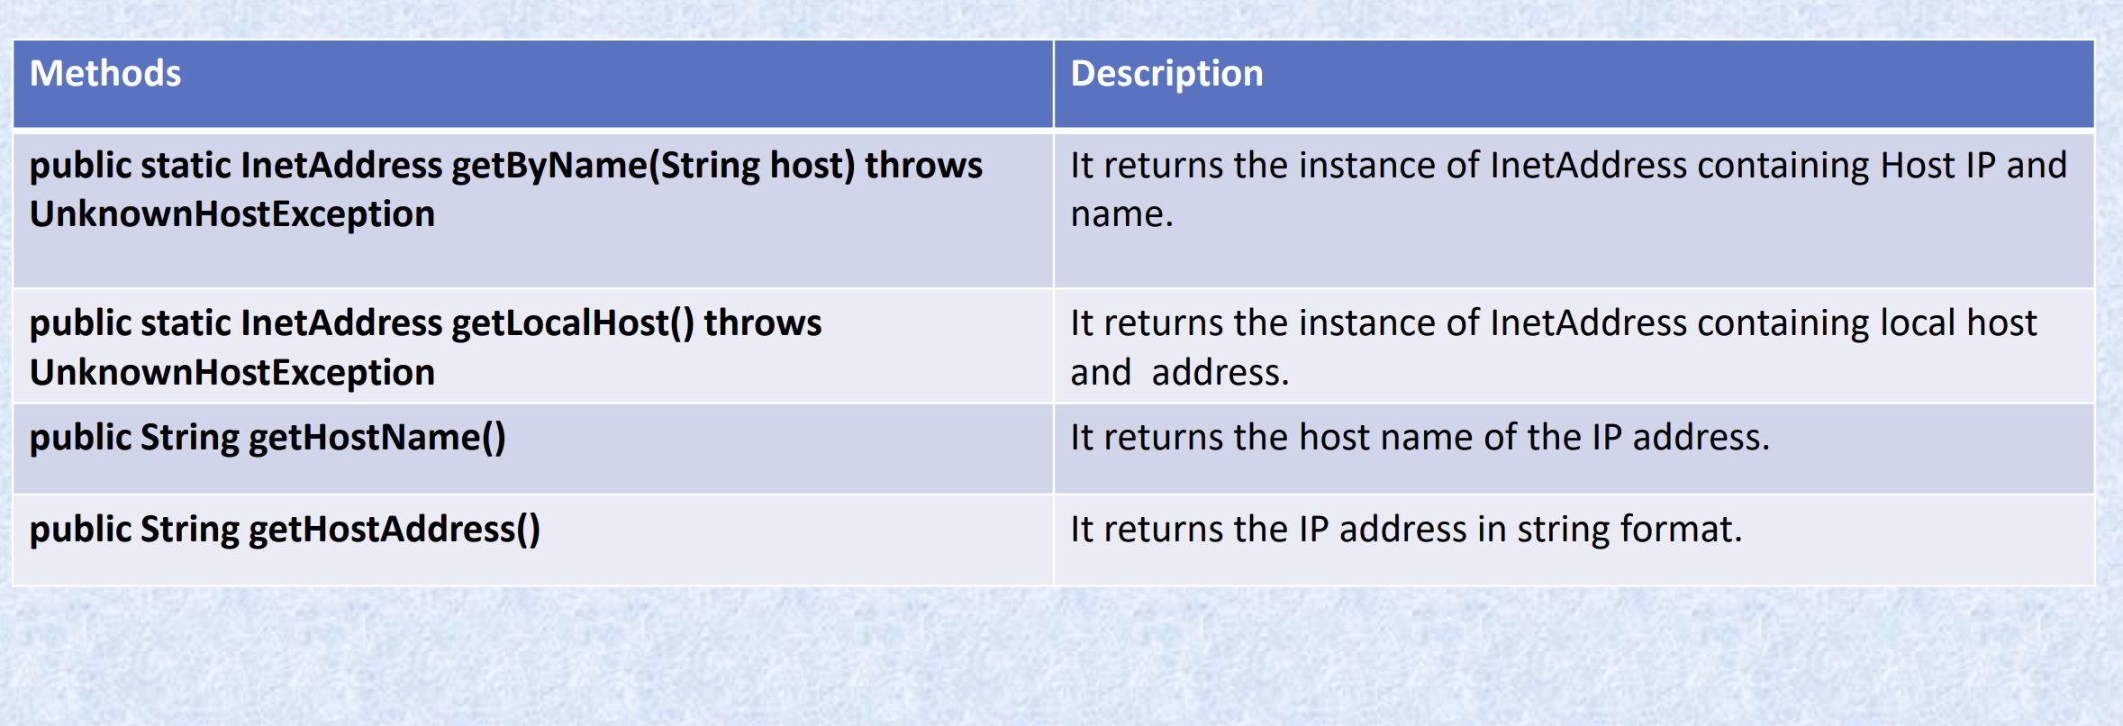
Getter Methods

Slide 8
The InetAddress class contains four getter methods that return the hostname as a string and the IP address as both a string and a byte array:
public String getHostName()
public String getCanonicalHostName()
public byte[] getAddress()
public String getHostAddress()
There are no corresponding setHostName() and setAddress() methods, which means that packages outside of java.net can’t change an InetAddress object’s fields behind its back. This makes InetAddress immutable and thus thread safe.
The getHostName() method returns a String that contains the name of the host with the IP address represented by this InetAddress object. If the machine in question doesn’t have a hostname or if the security manager prevents the name from being determined, a dotted quad format of the numeric IP address is returned. For example:
InetAddress machine = InetAddress.getLocalHost(); System.out.println(machine.getHostName());

Slide 9
The getCanonicalHostName() method is similar, but it’s a bit more aggressive about contacting DNS. getHostName() will only call DNS if it doesn’t think it already knows the hostname. getCanonicalHostName() calls DNS if it can, and may replace the existing cached hostname.
For example:
InetAddress machine = InetAddress.getLocalHost();
String localhost = machine.getCanonicalHostName();
The getCanonicalHostName() method is particularly useful when you’re starting with a dotted quad IP address rather than the hostname.

Slide 10
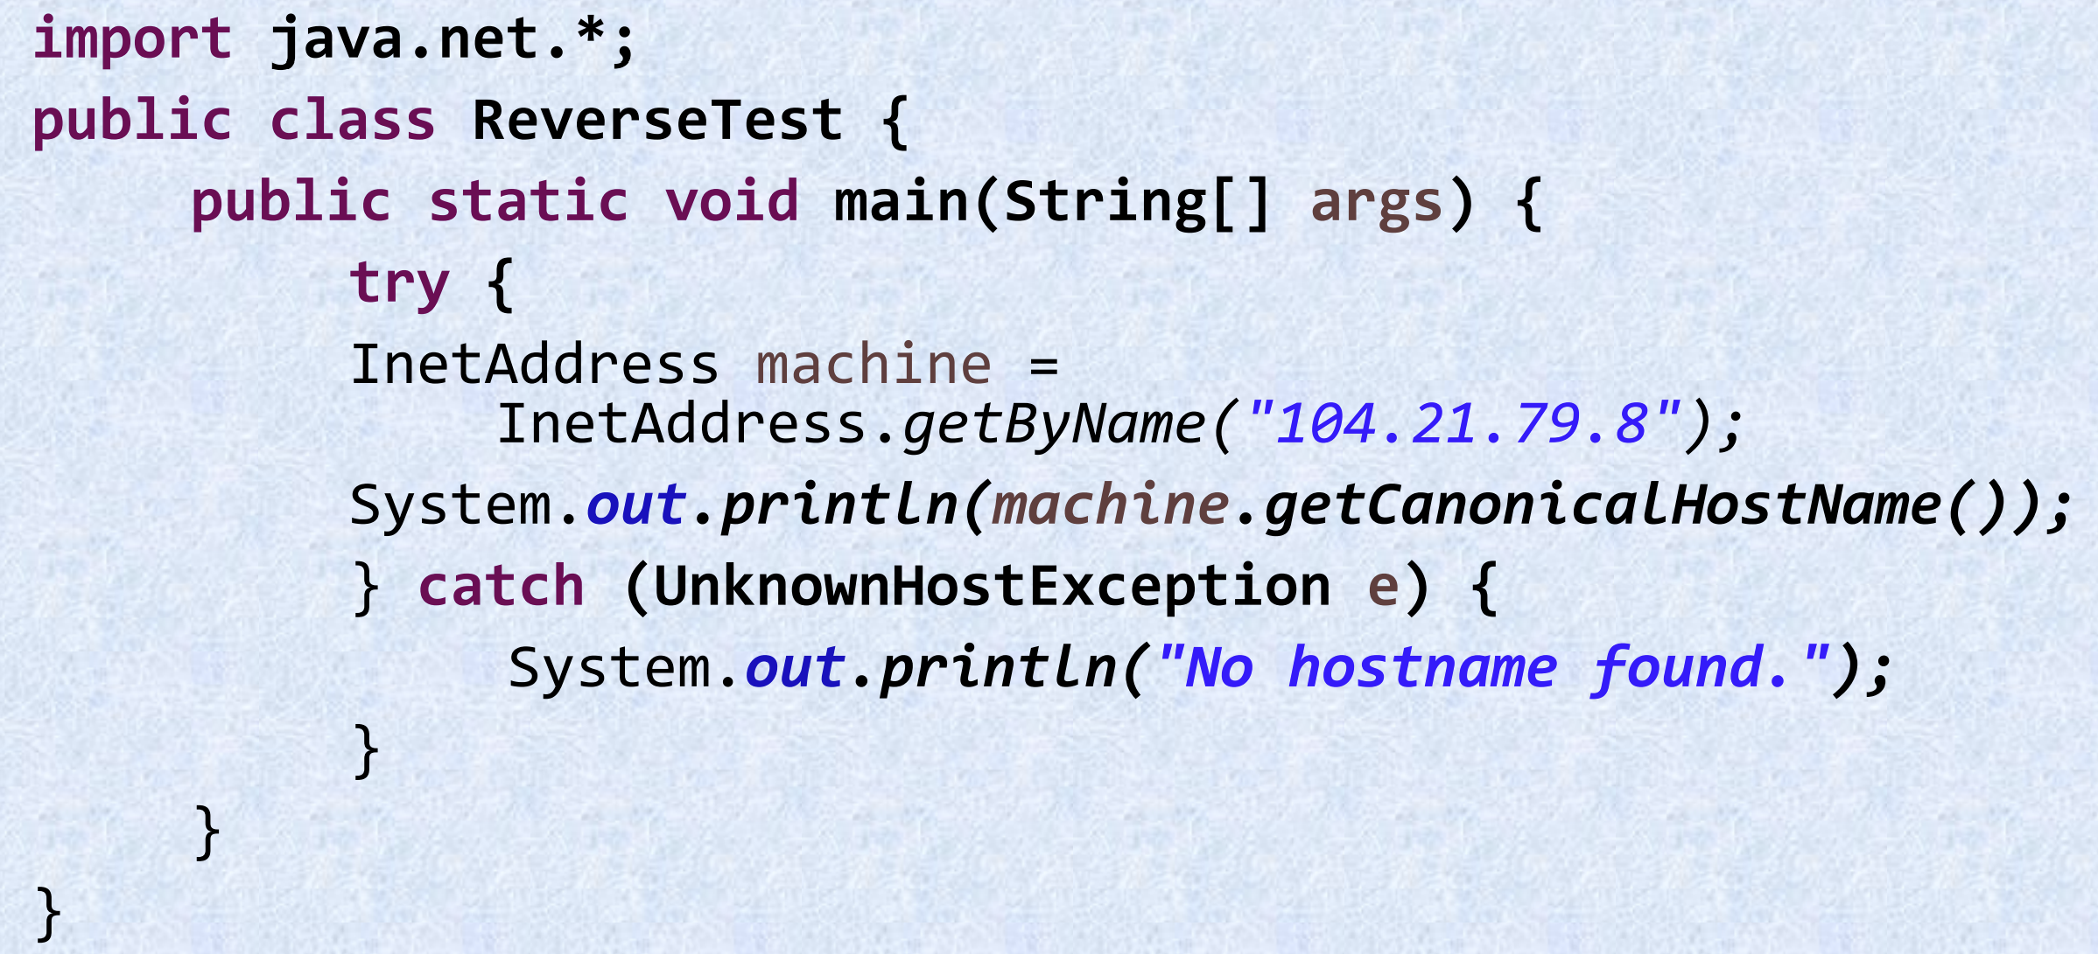
Given the address, find the hostname.

Slide 11
If you want to know the IP address of a machine, then use the getAddress() method, which returns an IP address as an array of bytes in network byte order. If you need to know the length of the array, use the array’s length field:
InetAddress me = InetAddress.getLocalHost();
byte[] address = me.getAddress();
The bytes returned are unsigned, which poses a problem. Unlike C, Java doesn’t have an unsigned byte primitive data type. Bytes with values higher than 127 are treated as negative numbers. Therefore, if you want to do anything with the bytes returned by getAddress(), you need to promote the bytes to ints and make appropriate adjustments. Here’s one way to do it:
int unsignedByte = signedByte < 0 ? signedByte + 256 : signedByte;
Here, signedByte may be either positive or negative. The conditional operator ? tests whether signedByte is negative. If it is, 256 is added to signedByte to make it positive. Otherwise, it’s left alone.
One reason to look at the raw bytes of an IP address is to determine the type of the address. Test the number of bytes in the array returned by getAddress() to determine whether you’re dealing with an IPv4 or IPv6 address

Slide 12
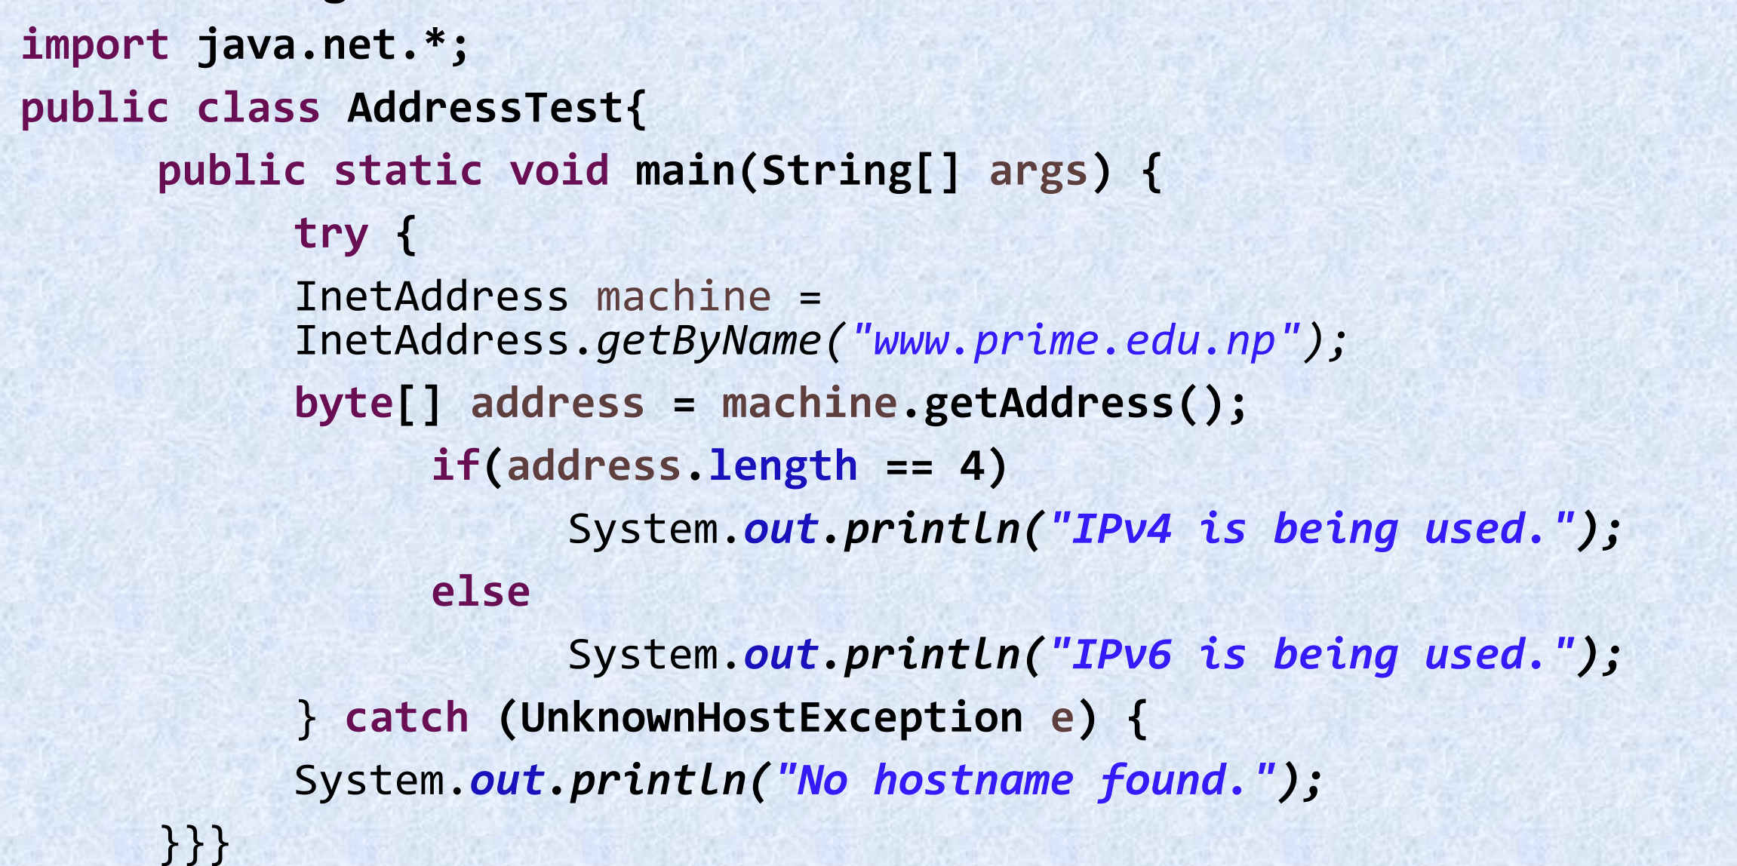
Determining whether an IP address is v4 or v6.

Slide 13
Address Types, Testing Reachability and Object Methods
Address Types
Some IP addresses and some patterns of addresses have special meanings. For instance, 127.0.0.1 is the local loopback address. IPv4 addresses in the range 224.0.0.0 to 239.255.255.255 are multicast addresses that send to several subscribed hosts at once. Java includes 10 methods for testing whether an InetAddress object meets any of these criteria:
1. public boolean isAnyLocalAddress()
2. public boolean isLoopbackAddress()
3. public boolean isLinkLocalAddress()
4. public boolean isSiteLocalAddress()
5. public boolean isMulticastAddress()
6. public boolean isMCGlobal()
7. public boolean isMCNodeLocal()
8. public boolean isMCLinkLocal()
9. public boolean isMCSiteLocal()
10. public boolean isMCOrgLocal()

Slide 14
The isAnyLocalAddress() method returns true if the address is a wildcard address, false otherwise. In IPv4, the wildcard address is 0.0.0.0. In IPv6, this address is 0:0:0:0:0:0:0:0 (a.k.a. ::).
The isLoopbackAddress() method returns true if the address is the loopback address, false otherwise. In IPv4, this address is 127.0.0.1. In IPv6, this address is 0:0:0:0:0:0:0:1 (a.k.a. ::1).
The isLinkLocalAddress() method returns true if the address is an IPv6 link-local address, false otherwise. This is an address used to help IPv6 networks self-configure, much like DHCP on IPv4 networks but without necessarily using a server. Routers do not forward packets addressed to a link-local address beyond the local subnet. All linklocal addresses begin with the eight bytes FE80:0000:0000:0000. The next eight bytes are filled with a local address, often copied from the Ethernet MAC address assigned by the Ethernet card manufacturer.
The isSiteLocalAddress() method returns true if the address is an IPv6 site-local address, false otherwise. Site-local addresses are similar to link-local addresses except that they may be forwarded by routers within a site or campus but should not be forwarded beyond that site. Site-local addresses begin with the eight bytes FEC0:0000:0000:0000. The next eight bytes are filled with a local address, often copied from the Ethernet MAC address assigned by the Ethernet card manufacturer.
The isMulticastAddress() method returns true if the address is a multicast address, false otherwise. Multicasting broadcasts content to all subscribed computers rather than to one particular computer. In IPv4, multicast addresses all fall in the range 224.0.0.0 to 239.255.255.255. In IPv6, they all begin with byte FF

Slide 15
The isMCGlobal() method returns true if the address is a global multicast address, false otherwise. A global multicast address may have subscribers around the world. All multicast addresses begin with FF. In IPv6, global multicast addresses begin with FF0E or FF1E depending on whether the multicast address is a well known permanently assigned address or a transient address. In IPv4, all multicast addresses have global scope.
The isMCOrgLocal() method returns true if the address is an organization-wide multicast address, false otherwise. An organization-wide multicast address may have subscribers within all the sites of a company or organization, but not outside that organization. Organization multicast addresses begin with FF08 or FF18, depending on whether the multicast address is a well known permanently assigned address or a transient address.
The isMCSiteLocal() method returns true if the address is a site-wide multicast address, false otherwise. Packets addressed to a site-wide address will only be transmitted within their local site. Site-wide multicast addresses begin with FF05 or FF15, depending on whether the multicast address is a well known permanently assigned address or a transient address.
The isMCLinkLocal() method returns true if the address is a subnet-wide multicast address, false otherwise. Packets addressed to a link-local address will only be transmitted within their own subnet. Link-local multicast addresses begin with FF02 or FF12, depending on whether the multicast address is a well known permanently assigned address or a transient address.
The isMCNodeLocal() method returns true if the address is an interface-local multicast address, false otherwise. Packets addressed to an interface-local address are not sent beyond the network interface from which they originate, not even to a different network interface on the same node. This is primarily useful for network debugging and testing. Interface-local multicast addresses begin with the two bytes FF01 or FF11, depending on whether the multicast address is a well known permanently assigned address or a transient address.

Slide 16
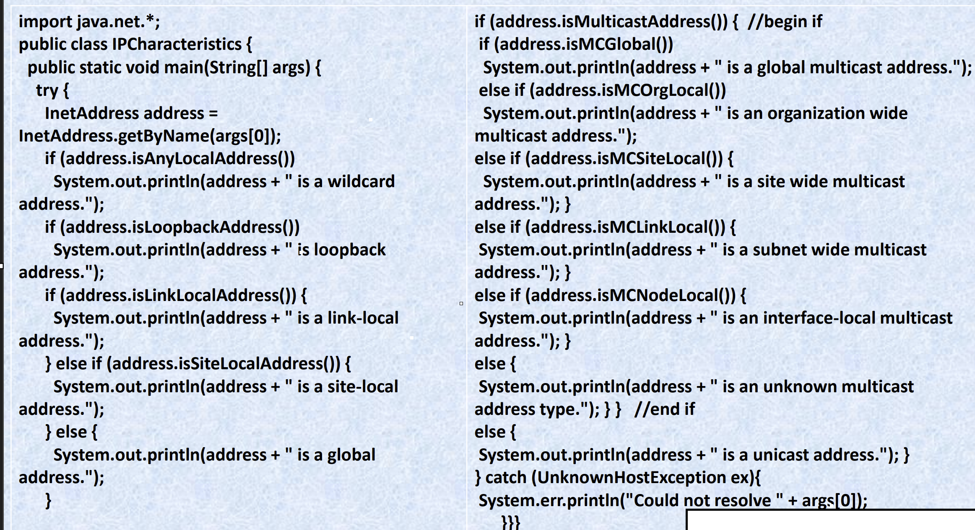
Testing the characteristics of an IP address

Slide 17
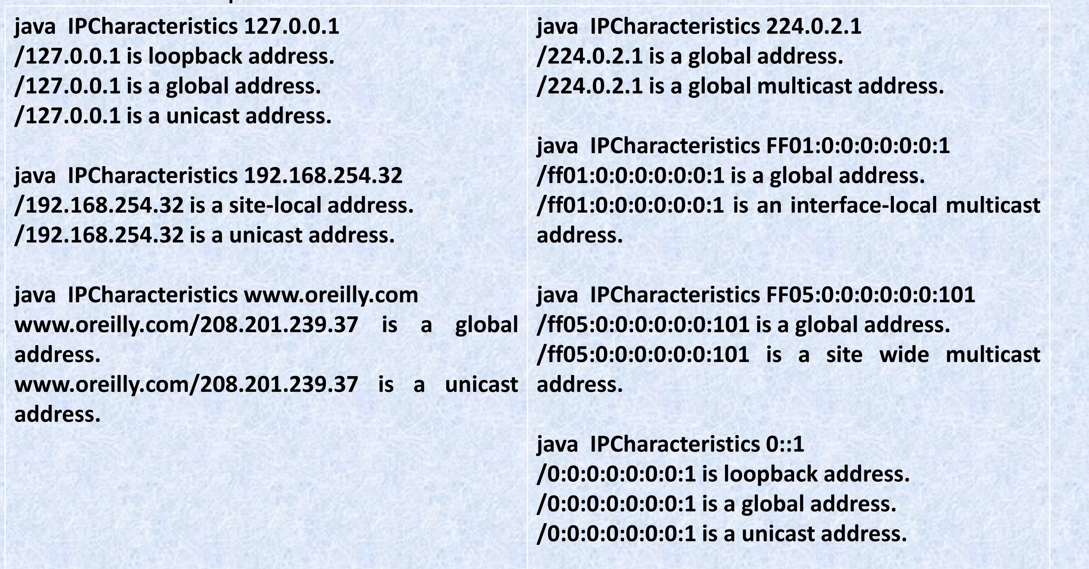
the output from an IPv4 and IPv6 address:

Slide 18
Testing Reachability
The InetAddress class has two isReachable() methods that test whether a particular node is reachable from the current host (i.e., whether a network connection can be made). Connections can be blocked for many reasons, including firewalls, proxy servers, misbehaving routers, and broken cables, or simply because the remote host is not turned on when you try to connect.
public boolean isReachable(int timeout) throws IOException
public boolean isReachable(NetworkInterface interface, int ttl, int timeout) throws IOException
These methods attempt to use traceroute (more specifically, ICMP echo requests) to find out if the specified address is reachable. If the host responds within timeout milliseconds, the methods return true; otherwise, they return false. An IOException will be thrown if there’s a network error. The second variant also lets you specify the local network interface the connection is made from and the “time-to-live” (the maximum number of network hops the connection will attempt before being discarded)

Slide 19
Object Methods
Like every other class, java.net.InetAddress inherits from java.lang.Object. Thus, it has access to all the methods of that class. It overrides three methods to provide more specialized behavior:
public boolean equals(Object o)
public int hashCode()
public String toString()
An object is equal to an InetAddress object only if it is itself an instance of the InetAddress class and it has the same IP address. It does not need to have the same hostname. Thus, an InetAddress object for www.ibiblio.org is equal to an InetAddress object for www.cafeaulait.org because both names refer to the same IP address. (only check ip whether sites are on same server-shared web hosting)

Slide 20
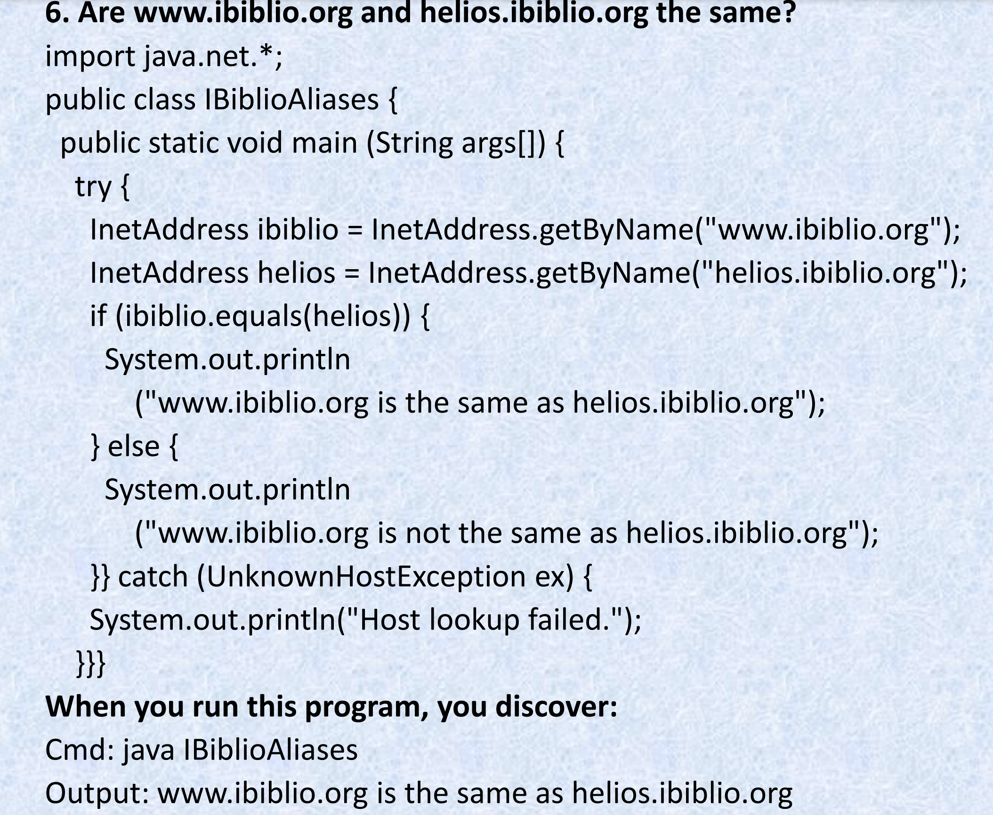

Slide 21
The hashCode() method is consistent with the equals() method. The int that hashCode() returns is calculated solely from the IP address. It does not take the hostname into account. If two InetAddress objects have the same address, then they have the same hash code, even if their hostnames are different.
` Like all good classes, java.net.InetAddress has a toString() method that returns a short text representation of the object. Example 1 implicitly called this method when passing InetAddress objects to System.out.println(). As you saw, the string produced by toString() has the form:
hostname/dotted quad address
Not all InetAddress objects have hostnames. If one doesn’t, the dotted quad address is substituted in Java 1.3 and earlier. In Java 1.4 and later, the hostname is set to the empty string

Slide 22
Inet4Address and Inet6Address
Java uses two classes, Inet4Address and Inet6Address, in order to distinguish IPv4 addresses from IPv6 addresses:
public final class Inet4Address extends InetAddress
public final class Inet6Address extends InetAddress
Inet4Address overrides several of the methods in InetAddress but doesn’t change their behavior in any public way.
Inet6Address is similar, but it does add one new method not present in the superclass, isIPv4CompatibleAddress():
public boolean isIPv4CompatibleAddress() •
This method returns true if and only if the address is essentially an IPv4 address stuffed into an IPv6 container—which means only the last four bytes are nonzero. That is, the address has the form 0:0:0:0:0:0:0:xxxx. If this is the case, you can pull off the last four bytes from the array returned by getBytes() and use this data to create an Inet4Address instead. However, you rarely need to do this.

Slide 23
The Network Interface Class: Factory Method & Getter Method
The NetworkInterface Class
The NetworkInterface class represents a local IP address.
This can either be a physical interface such as an additional Ethernet card (common on firewalls and routers) or it can be a virtual interface bound to the same physical hardware as the machine’s other IP addresses.
The NetworkInterface class provides methods to enumerate all the local addresses, regardless of interface, and to create InetAddress objects from them.
These InetAddress objects can then be used to create sockets, server sockets, and so forth.

Slide 24
Factory method
Because NetworkInterface objects represent physical hardware and virtual addresses, they cannot be constructed arbitrarily. As with the InetAddress class, there are static factory methods that return the NetworkInterface object associated with a particular network interface. You can ask for a NetworkInterface by IP address, by name, or by enumeration
public static NetworkInterface getByName(String name) throws SocketException
The getByName() method returns a NetworkInterface object representing the network interface with the particular name. If there’s no interface with that name, it returns null. If the underlying network stack encounters a problem while locating the relevant network interface, a SocketException is thrown, but this isn’t too likely to happen.

Slide 25
The format of the names is platform dependent. On a typical Unix system,
the Ethernet interface names have the form eth0, eth1, and so forth. The
local loopback address is probably named something like “lo”. On
Windows, the names are strings like “CE31” and “ELX100” that are derived
from the name of the vendor and model of hardware on that particular
network interface. For example, this code fragment attempts to find the
primary Ethernet interface on a Unix system

Slide 26
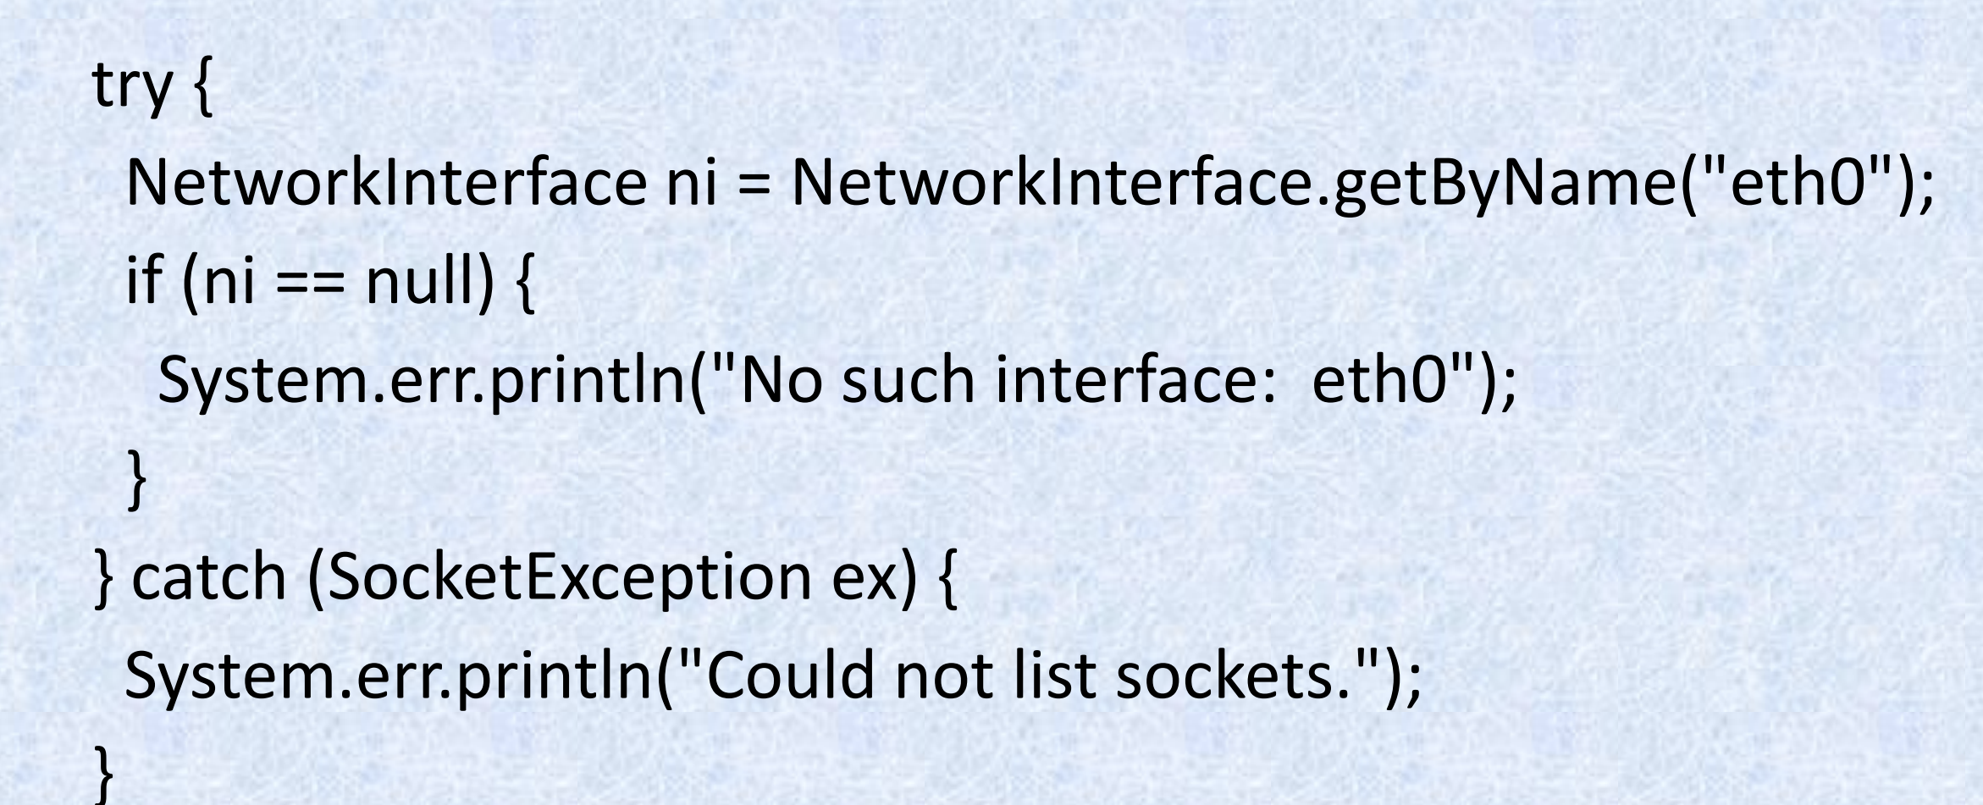

Slide 27
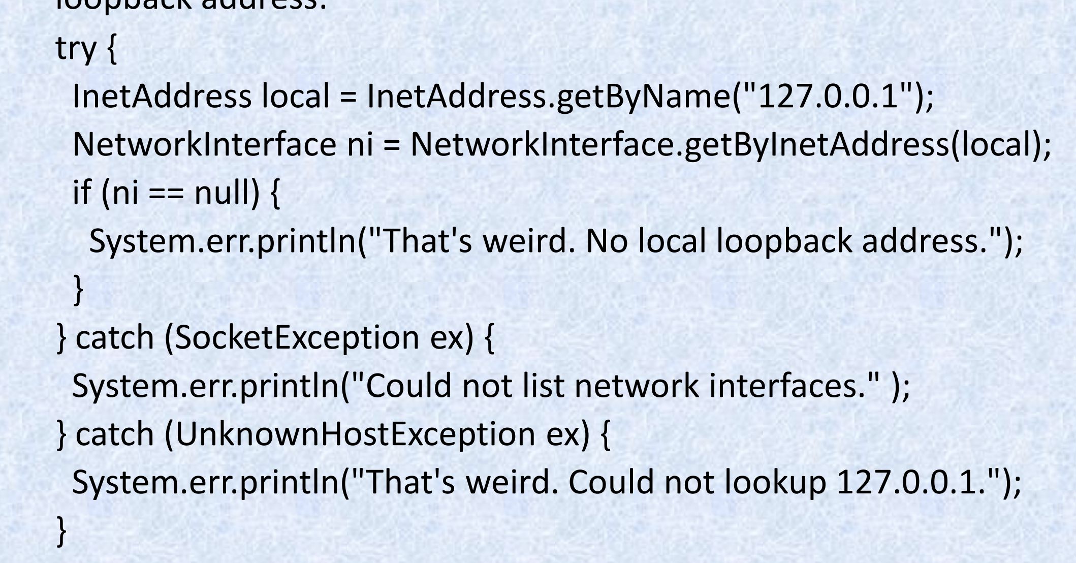
public static NetworkInterface getByInetAddress(InetAddress address) throws SocketException
The getByInetAddress() method returns a NetworkInterface object representing the network interface bound to the specified IP address. If no network interface is bound to that IP address on the local host, it returns null. If anything goes wrong, it throws a SocketException. For example, this code fragment finds the network interface for the local loopback address:

Slide 28
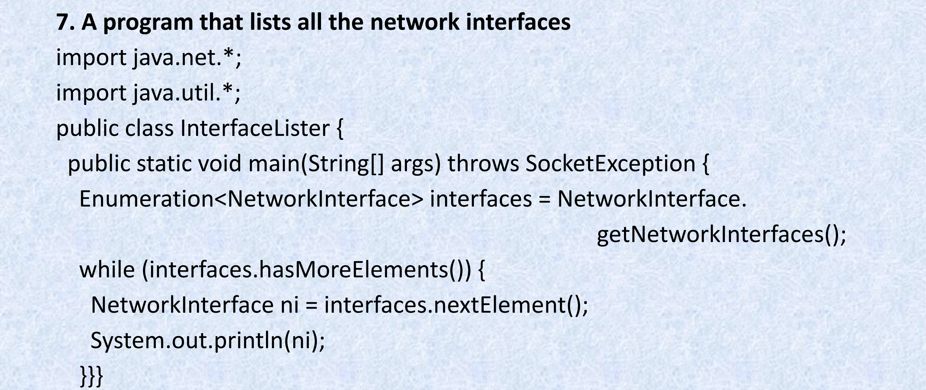
The getNetworkInterfaces() method returns a java.util.Enumeration listing all the network interfaces on the local host. Example below is a simple program to list all network interfaces on the local host:

Slide 29
Here’s the result of running this on the IBiblio login server: Cmd: java InterfaceLister Output:
name:eth1 (eth1) index: 3 addresses:
/192.168.210.122;
name:eth0 (eth0) index: 2 addresses:
/152.2.210.122;
name:lo (lo) index: 1 addresses:
/127.0.0.1;
You can see that this host has two separate Ethernet cards plus the local loopback address. The Ethernet card with index 2 has the IP address 152.2.210.122. The Ethernet card with index 3 has the IP address 192.168.210.122. The loopback interface has address 127.0.0.1, as always.

Slide 30
Getter Methods
• Once you have a NetworkInterface object, you can inquire about its IP address and name. This is pretty much the only thing you can do with these objects.
public Enumeration getInetAddresses()
A single network interface may be bound to more than one IP address. This situation isn’t common these days, but it does happen. The getInetAddresses() method returns a java.util.Enumeration containing an InetAddress object for each IP address the interface is bound to. For example, this code fragment lists all the IP addresses for the eth0 interface:

Slide 31
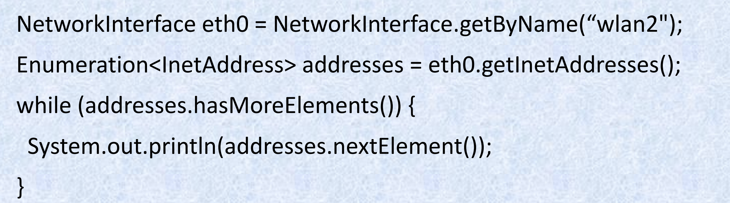

Slide 32
public String getName()
The getName() method returns the name of a particular NetworkInterface object, such as eth0 or lo.
public String getDisplayName()
The getDisplayName() method allegedly returns a more human-friendly name for the particular NetworkInterface—something like “Ethernet Card 0.” However, in my tests on Unix, it always returned the same string as getName(). On Windows, you may see slightly friendlier names such as “Local Area Connection” or “Local Area Connection 2.”

Slide 33
Some Useful Programs: SpamCheck, Processing Web Server Logfiles
Here you’ll look at two examples: one that queries your domain name server interactively and another that can improve the performance of your web server by processing logfiles offline.
SpamCheck
To find out if a certain IP address is a known spammer, reverse the bytes of the address, add the domain of the blackhole service(service monitoring spammers and inform clients), and look it up. If the address is found, it’s a spammer. If it isn’t, it’s not.
For instance, if you want to ask sbl.spamhaus.org if 207.87.34.17 is a spammer, you would look up the hostname 17.34.87.207.sbl.spamhaus.org.
If the DNS query succeeds then the host is known to be a spammer. If the lookup fails— that is, it throws an UnknownHostException—it isn’t.

Slide 34
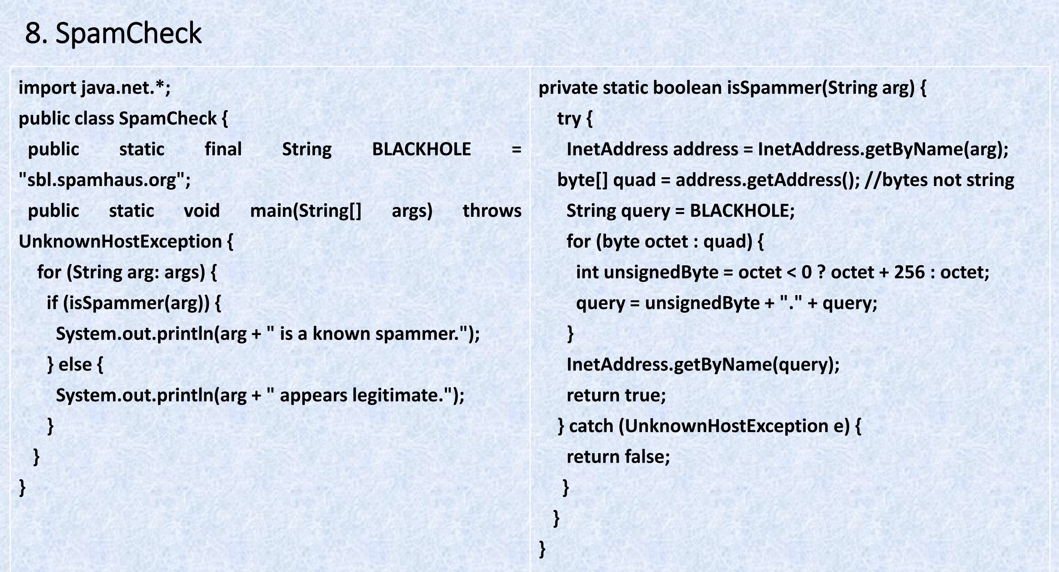

Slide 35
Processing Web Server Logfiles
• Web server logs track the hosts that access a website. By default, the log reports the IP addresses of the sites that connect to the server. However, you can often get more information from the names of those sites than from their IP addresses. Most web servers have an option to store hostnames instead of IP addresses, but this can hurt performance because the server needs to make a DNS request for each hit. It is much more efficient to log the IP addresses and convert them to hostnames at a later time, when the server isn’t busy or even on another machine completely. Example 9 is a program called Weblog that reads a web server logfile and prints each line with IP addresses converted to hostnames.
Most web servers have standardized on the common logfile format. A typical line in the common logfile format looks like this:

Slide 36
205.160.186.76 unknown - [17/Jun/2013:22:53:58 -0500] "GET /bgs/greenbg.gif HTTP 1.0" 200 50
This line indicates that a web browser at IP address 205.160.186.76 requested the file /bgs/greenbg.gif from this web server at 11:53 P.M (and 58 seconds) on June 17, 2013. The file was found (response code 200) and 50 bytes of data were successfully transferred to the browser. •
The first field is the IP address or, if DNS resolution is turned on, the hostname from which the connection was made. This is followed by a space. Therefore, for our purposes, parsing the logfile is easy: everything before the first space is the IP address, and everything after it does not need to be changed.
The dotted quad format IP address is converted into a hostname using the usual methods of java.net.InetAddress. PREPARED BY

Slide 37
